Slide 1
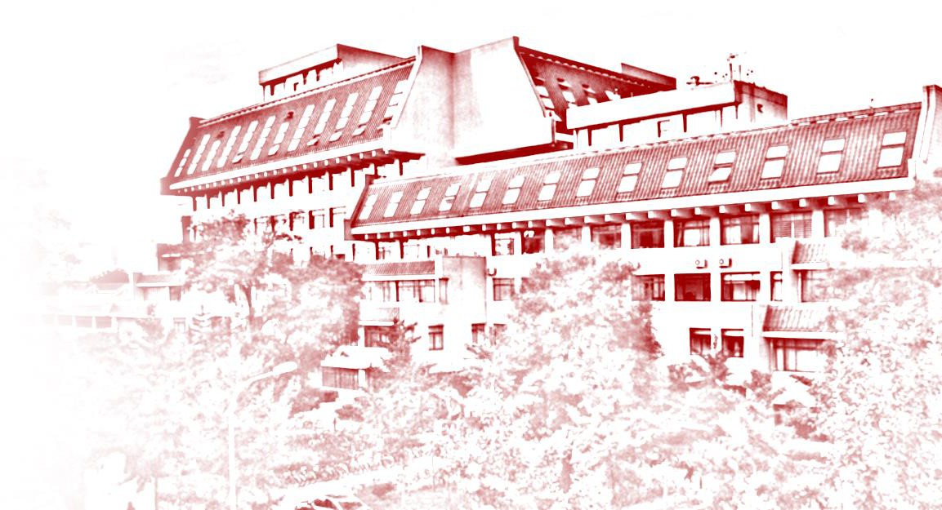
Transfer learning
蔡臣静 1701111432 叉院
王磊 1701111453 叉院
何旭峥 1700010685 数院
王好庆 1901111352 信科

Slide 2
Contents
Introduction
Fine-tuning
Domain adaptation
Transfer learning and meta learning

Slide 3
Introduction
蔡臣静 1701111432 CQB

Slide 4
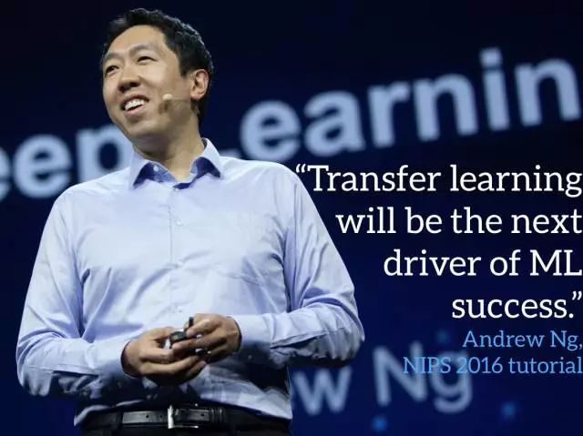
Introduction
Build every model from scratch:
Data collection cost
Computing resource
Time consuming
Supervised learning
Transfer learning
Commercial
success
Unsupervised learning
Reinforcement learning
Time
- Andrew Ng, NIPS 2016 tutorial

Slide 5
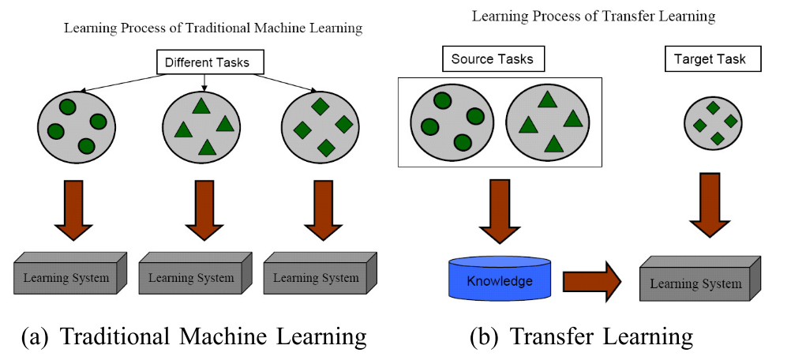
Introduction
Transfer learning emphasizes the transfer of knowledge across domains, tasks, and distributions that are similar but not the same.[1.1]

Slide 6
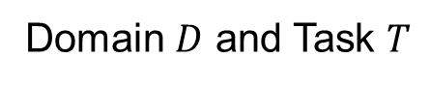
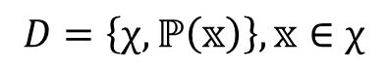
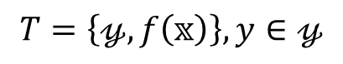
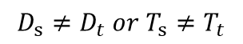
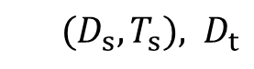
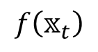
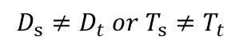
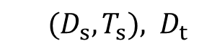
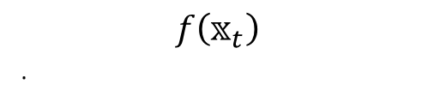
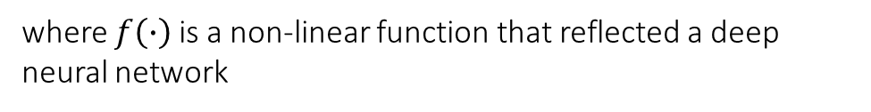
Notations and Definitions [1.2]
Transfer Learning:
Deep Transfer Learning:

Slide 7
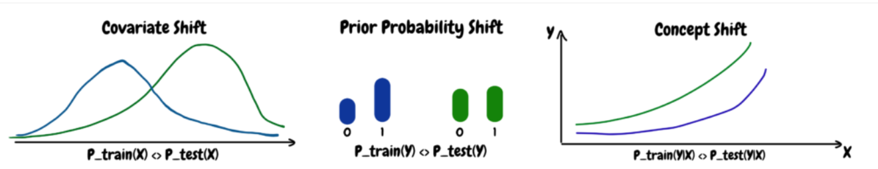
Transfer learning and Domain adaptation
Transfer learning: Transfer learning is defined as the general case where the domains are freely allowed to differ in sample space, label space, distribution or all.
Domain adaptation: Domain adaptation is defined as the particular case where the sample and label spaces remain unchanged and only the probability distributions change. [1.3]
Covariate Shift
Prior Probability shift
Concept shift
https://dkopczyk.quantee.co.uk/covariate_shift/

Slide 8
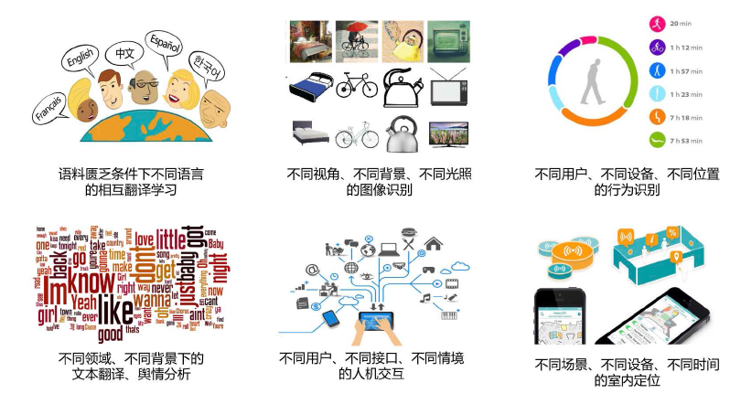
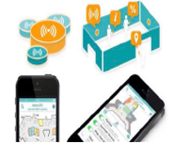
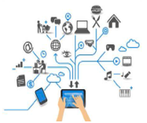
Application
Translation
Object Detection
Activity Recognition
Review Analysis
Indoor Localization
Man-machine Interaction

Slide 9
Approaches “shallow models”
Instanced-based methods
Feature-based methods
Model-based methods
Relation-based methods

Slide 10
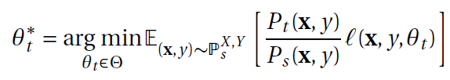
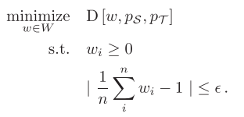
Approaches “shallow models”
Instance-based methods: reusing the source data to help target learning through importance weighting
Weight Estimate:
Estimating each probability distribution,
Gaussian distribution, KDE, etc.
Estimating ratio directly

Slide 11
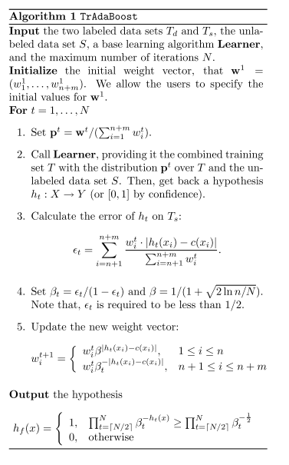
Instance-based methods:
TrAdaBoost[1.4]
Target data
AdaBoost
learner
Source data
Hedge(β)

Slide 12
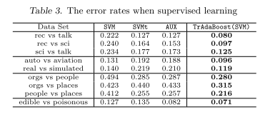
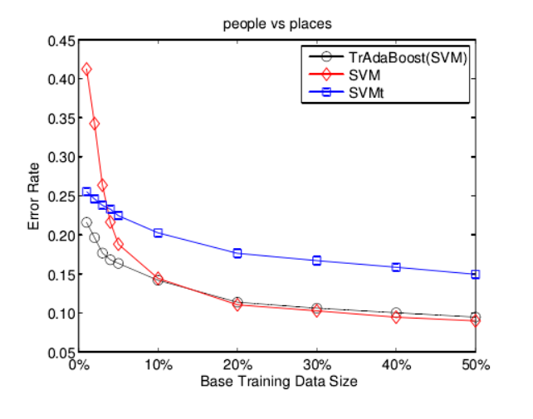
TrAdaBoost：

Slide 13
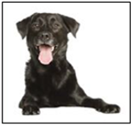
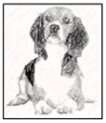
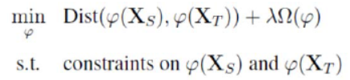
Approaches “shallow models”
Feature-based methods: learn good feature representation of source domain and target domain
Source domain (image)
Dog
Feature
extractor
Target domain (picture)
Dog

Slide 14
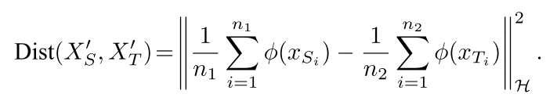
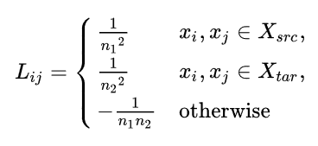
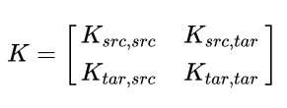
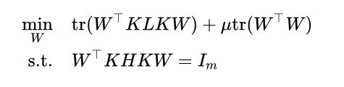
Transfer Components Analysis (TCA) [1.5]:
Maximum Kernel Discrepancy (MMD):

Slide 15
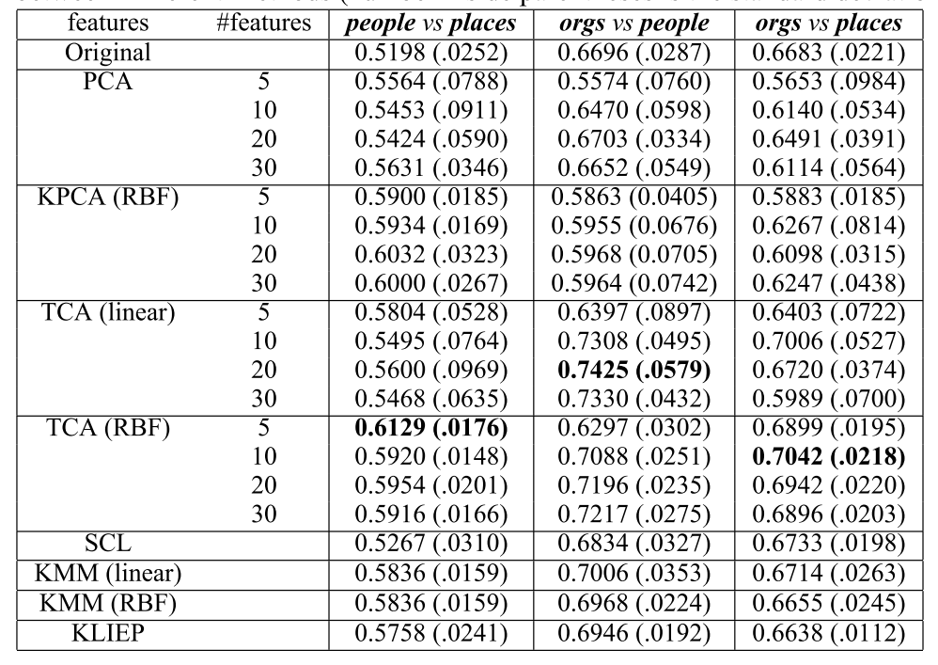
Transfer Components Analysis (TCA):

Slide 16
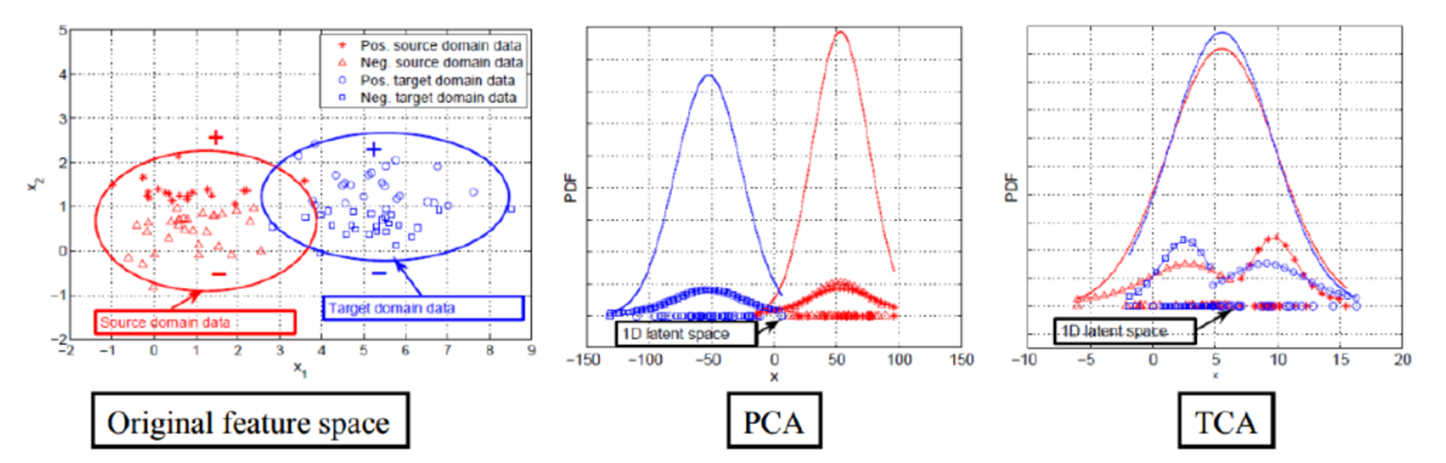
Transfer Components Analysis (TCA):

Slide 17
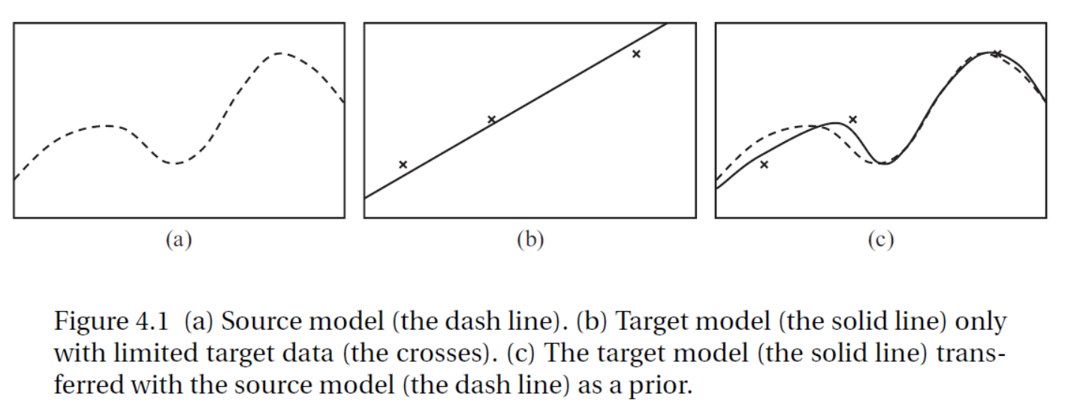
Approaches “shallow models”
Model-based methods: transfer model parameters or model structures to transfer knowledge

Slide 18
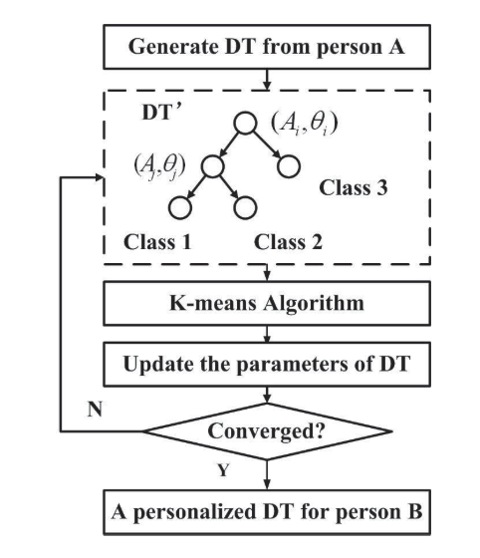
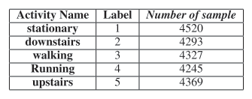
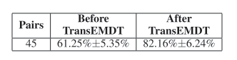
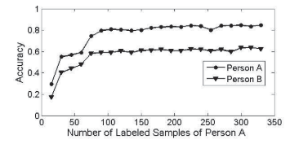
Transfer learning Embedded Decision Tree (TransEMDT) [1.6]:

Slide 19
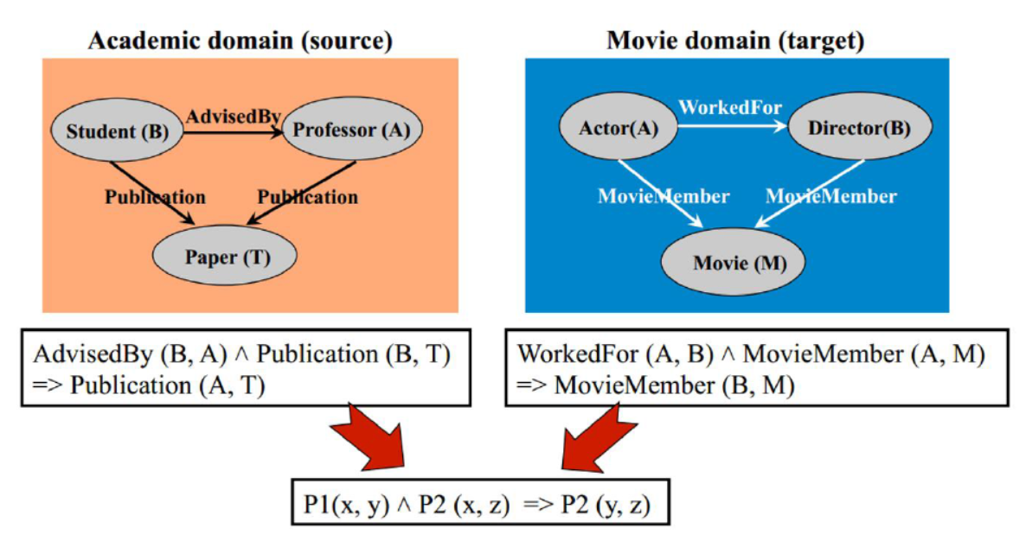
Approaches “shallow models”
Relation-based methods: building the mapping of the relational knowledge between the source relational domain and target domain.[1.7]

Slide 20
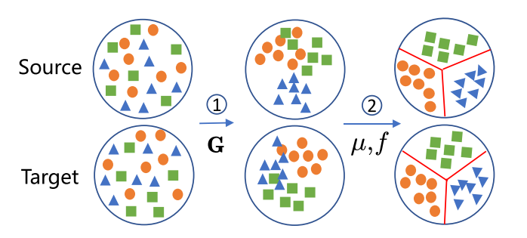
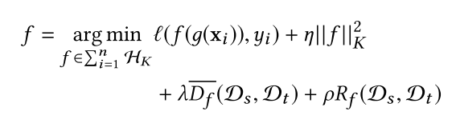
State of the art traditional transfer learning methods
Manifold Embedded Distribution Alignment (MEDA) [1.8]

Slide 21
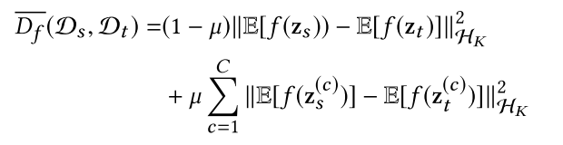
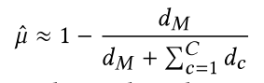
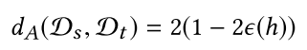
Manifold Embedded Distribution Alignment (MEDA):

Slide 22
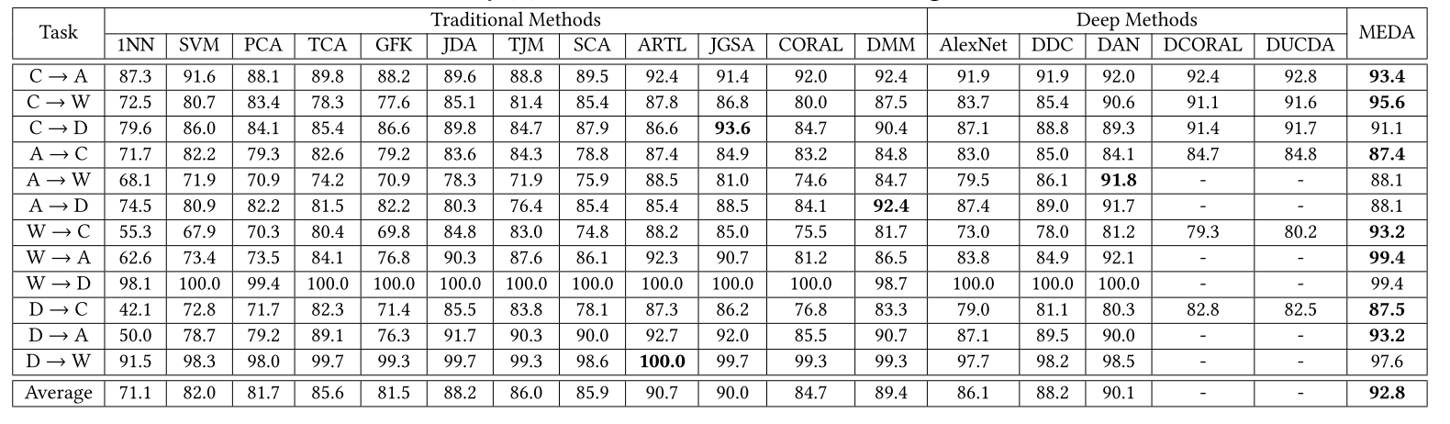
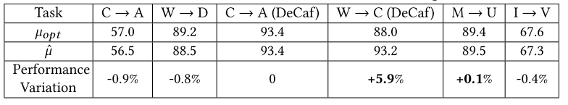
Manifold Embedded Distribution Alignment (MEDA):

Slide 23
Summary
Finding the similarity of the domains in different levels
Non parametric
High Interpretability
Designed feature extractor and distance function

Slide 24
Fine-tuning
王磊 1701111453 CQB

Slide 25
Pre-trained models
Feature Extraction from pre-trained model and then training a classifier on top of it.
Fine tuning a pre-trained model keeping learnt weights as initial parameters.
Use the Architecture of the pre-trained model
Train some layers while freeze others
Task description
Source data: (x^{S}, y^{S})
Target data: (x^{t}, y^{t})
A large amount
Very little

Slide 26
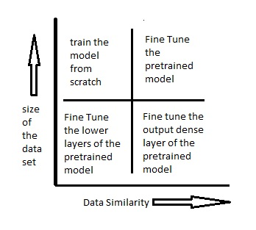
Fine-tune
Size of the data set
Data similarity
https://data-flair.training/blogs/transfer-learning/

Slide 27
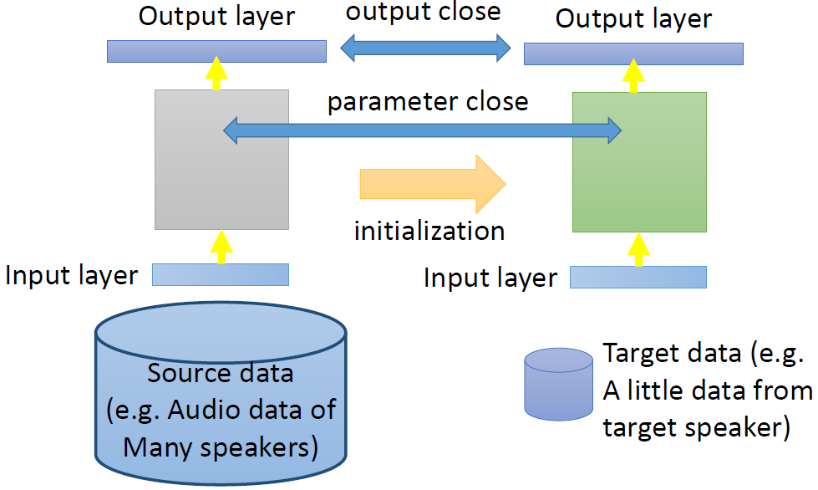
Conservative Training

Slide 28
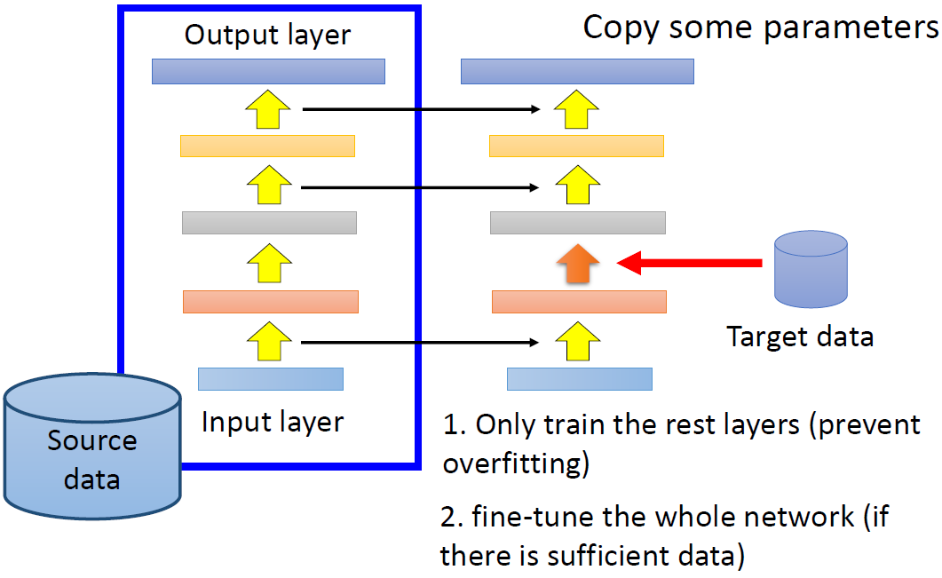
Layer transfer
Freeze

Slide 29
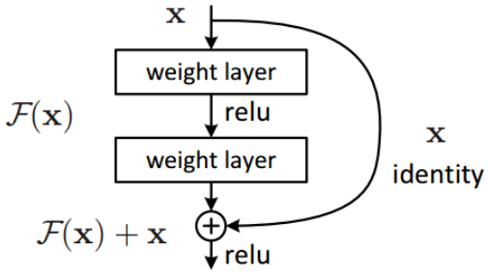
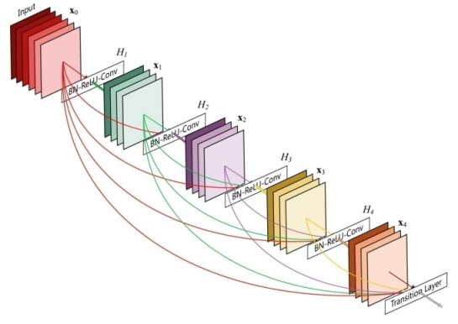
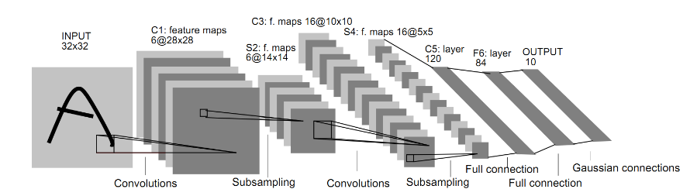

Conservative Training - Image
Do Better ImageNet Models Transfer Better?

Slide 30

Layer transfer - Image
Which layer can be transferred?
•Speech: usually copy the last few layers
•Image: usually copy the first few layers
How to fine tune better?

Slide 31


Do Better ImageNet Models Transfer Better?

Slide 32
The relationship between architecture and transfer.
Models that perform better on ImageNet necessarily perform better on other vision tasks?
Better network architectures learn better features that can be transferred across vision-based tasks?

Slide 33
Tricks for image classification with CNN networks
CNN networks:
ResNet-50
Inception-V3
MobileNet
Dataset:
ISLVRC2012
(1.3 million images for training and 1000 classes)
Efficient training
Model tweaks
Training refinements
Mixup training
Transfer learning

Slide 34



Tricks for image classification with CNN networks
Efficient Training
Lower numerical precision
(BS=1024 with FP16)
(BS=256 with FP32)

Slide 35



Tricks for image classification with CNN networks
Model Tweaks
Downsample
Input
Downsample

Slide 36




Tricks for image classification with CNN networks
Training refinements
Cosine Learning Rate Decay
Label Smoothing
Knowledge Distillation

Slide 37



Tricks for image classification with CNN networks
Mixup training
Data augmentation

Slide 38


Object detection (locate bounding boxes of objects in an image)
Semantic segmentation (the category for every pixel)
Model: Faster-RCNN
Dataset: PASCAL VOC
Model: Fully Convolutional Network (FCN)
Dataset: ADE20K
Improvement on image classification accuracy leads to better transfer learning performance in other application domains such as object detection and semantic segmentation.

Slide 39
The relationship between architecture and transfer.
Models that perform better on ImageNet necessarily perform better on other vision tasks?
Better network architectures learn better features that can be transferred across vision-based tasks?
16 classification networks
12 image classification datasets
Fixed feature extractors
Fine-tuned from imageNet initialization
Trained from random initialization

Slide 40


12 image classification datasets
12 image classification datasets
16 classification networks

Slide 41

Logistic Regression (fixed feature extractors)
()

Slide 42

Fine-tune

Slide 43

Trained from random initialization

Slide 44


Performance comparison
Performance comparison:
Logistic regression
Fine-tuning
Training from random initialization

Slide 45

Accelerates convergence

Slide 46

Dataset size

Slide 47


ImageNet training settings
Penultimate layer features
The absence of scale parameter γ for batch normalization layers
Label smoothing
Dropout
The presence of an auxiliary classifier head
Fine-tuning

Slide 48
ImageNet
Better ImageNet networks provide better penultimate layer features (linear classification) and better performance of fine-tuned;
Regularizers that improve ImageNet performance are highly detrimental to the performance of transfer learning based on penultimate layer features.

Slide 49

Which layer can be transferred?

Slide 50
Layer transfer - Image
Specific to a particular dataset or task
General in that they are applicable to many datasets and tasks (transferable)
General
Specific
Can we quantify the degree to which a particular layer is general or specific?
Does the transition occur suddenly at a single layer, or is it spread out over several layers?
Where does this transition take place: near the first, middle, or last layer of the network?

Slide 51

Generality vs. Specificity Measured as Transfer Performance
Tasks A and B
500 classes
645,000 examples
Eight-layer convolutional network
Freeze or Fine tune

Slide 52

Transfer Performance
Fragile co-adapted features

Slide 53

Random Weights
Natural

Slide 54

Number of examples per class

Slide 55
Conclusion
A way to quantify the degree to which a particular layer is general or specific;
Two separate issues that cause performance : (i) the specificity of the features themselves, and (ii) co-adapted neurons on neighboring layers;

Slide 56




How to fine tune better?

Slide 57
Fine tune
All the images in the target dataset should follow the same fine-tuning policy.
Deep neural networks often have millions of parameters, so when the pre-trained model is being applied on a relatively small target dataset, there is a danger of overfitting since the model is overparameterized for the target dataset.

Slide 58

SpotTune——adaptive fine-tuning
Where to fine-tune?
Freeze vs Fine tune
Learn a decision policy for input-dependent fine-tuning
12 out of 14 standard datasets

Slide 59





Lightweight
(only a few residual blocks (4))
Gumbel Softmax
SpotTune
Image-specific
Maximizes the accuracy of the target task
The fine-tune block
The frozen block
The same k blocks

Slide 60


SpotTune
All
50%
All
k=3

Slide 61

SpotTune

Slide 62

Visualization of Policies

Slide 63


SpotTune
Cleaner background
4
13

Slide 64
SpotTune
An input-dependent fine-tuning approach that automatically determines which layers to fine-tune per target instance;
A global variant that constrains all the input examples to fine-tune the same set of k layers which can be distributed anywhere in the network;
The proposed approach outperforms standard fine-tuning on 12 out of 14 datasets.

Slide 65

AdaFilter
Adaptive fine-tuning
Filter-level
Layer-level
Reduce the average classification error of the standard fine-tuning by 2.54%
Fine-tune

Slide 66

Layerwise Recurrent Gated Network

Slide 67


AdaFilter
AdaFilter

Slide 68

AdaFilter
Test accuracy curve

Slide 69

AdaFilter

Slide 70
AdaFilter
Filter selection, layer-wise recurrent gated network and gated batch normalization techniques to allow different images in the target dataset to fine-tune different convolutional filters in the pre-trained model.
AdaFilter can consistently perform better than the standard fine-tuning.

Slide 71


Continuous fine-tuning
Unlabeled
Preprocessing

Slide 72
Conclusion (fine tune)
Better imagenet models transfer better;
The specificity of the features and co-adapted neurons on neighboring layers will influence the process of fine-tune.
Input-dependent and adaptive fine-tuning approach can get better accuracy.

Slide 73
Domain Adaptation
何旭峥 1700010685 数院

Slide 74
Notation
Define a training step P as an update of neural network parameters:
P(θ, L | D, H):=update θ toward minimizing loss function L upon dataset D using hyper parameters H
D can be mini-batches
when fixed, H is omitted

Slide 75
Notation
In each training step P(θ, L | D), we seek to lower down the loss function by calculating the gradient:
θ ← θ – α ▽_{θ} L
In training step P(θ₁, L₁, θ₂, L₂, … | D) where {θ_{i}}’s are disjoint, it is understood that each θ_{i} is updated toward minimizing L_{i} using the same dataset, simultaneously
Use <P₁, P₂, …, P_{n}> to describe a finite loop, equivalent to {for t=1 to m {for i=1 to n {P_{i}}}}

Slide 76
Problem
In Domain Adaptation,
the source domain D_{s} and the target domain D_{t} share same representation (i.e. input space) X×Y but have different probability distribution p(x,y)
task: typically image classification on target domain
To address this problem using neural network, we effectively need to design:
1. an overall structure of the neural network
2. an algorithm using loops of training steps

Slide 77

Pre-training
Inductive Bias: Any neural network that performs well on D_{s} should perform well on D_{t}
⇒idea: initializing parameters using pre-trained models on the source domain
that is, execute <P(θ_{pre}, L_{cls} | D_{s})> before actually start utilizing data on the target domain

Slide 78
Unsupervised?
If data in the target domain are unlabeled, we cannot train directly with D_{t}!
Inductive Bias: the outputs of hidden layers (i.e. features) calculated on the target domain should be statistically similar to those calculated on source domain
⇒idea: add a domain loss to the loss function representing the “distance” of features between domains
various ways to implement

Slide 79



Method: Based on MMD^{[3.1]}
pre-training: without fc_adapt layer
training: with fc_adapt layer
<P(θ, L | D_{s} ∪ D_{t})>
↑ jointly trained on source and target data!

Slide 80




Method: Based on Autoencoders^{[3.2]}
pre-training: initialize all (W,b)’s by Stacked Autoencoders
training: <P((W, b), J | D_{s} ∪ D_{t})>

Slide 81


Method: Adversarial Discriminative Domain Adaptation^{[3.3]}
pre-training, then use θ_{Ms} to initialize θ_{Mt}
training:
<P(θ_{Mt}, L_{advM}, θ_{D}, L_{advD} | D_{s} ∪ D_{t})>

Slide 82




Method: Based on GAN^{[3.4]}
<P(θ_{D}, -L, θ_{T}, L | D_{s} ∪ D_{t}), P(θ_{G}, L | D_{s})>
↑ “gradient reversal”

Slide 83
Some general ideas
We present three general ideas that can be used to solve domain adaptation problems, each with an example:
meta learning
adversarial learning
add more blocks

Slide 84
Meta Learning
functions that appear in the loss function of one training step are used to calculate hyper parameters of another training step
For example:
<P(θ_{meta}, L(F_{meta}) | D), P(θ, L | D, H(F_{meta}))>
where F_{meta} = y(x;θ_{meta})

Slide 85

Problem: Partial Domain Adaptation
Y_{s} ⊋ Y_{t}, unsupervised on the target domain

Slide 86









Solution: Importance Weighting^{[3.5]}
H: entropy loss
G~_{y}: leaky softmax

Slide 87

Solution: Importance Weighting^{[3.5]}
<P(θ_{y~}, E_{Gy~} + E_{Gd~} | D_{s} ∪ D_{t}), P(θ_{f}, E_{Gy} – E_{Gd}, θ_{y},
E_{Gy} – E_{Gd}, θ_{d}, E_{Gd} | D_{s} ∪ D_{t}, W)>

Slide 88
Adversarial Learning
Adversarial Learning is a powerful technique which needs bi-directional reasoning

Slide 89

Problem: Open Set Domain Adaptation
Y_{s} ⊊ Y_{t}, unsupervised on the target domain

Slide 90

Solution^{[3.6]}
train the classifier to output p(y = K+1 | x_{t}) = t, 0 < t < 1
train the generator to deceive the classifier
so the generator will have to lead the classifier to “think” that p(y = K+1 | x_{t}) = 0 (i.e. known) or 1 (i.e. unknown)
t = 0.5

Slide 91
Add more blocks
Different blocks of neural network serve different objectives in a complex learning task
<P₁, P₂, …, P_{n}>, <Q₁, Q₂, …, Q_{m}>, …
first train one part of network, then train another part of network, and so on
A network of neural networks?

Slide 92
Problem: Zero-Shot Learning
Y_{s} ⊊ Y_{t}
every image class is described by some natural language, represented by attribute vectors in V
D_{att} describes Y_{s} (D_{att} = V × Y_{s})
D_{att`} describes Y_{t} \ Y_{s} (D_{att`} = V × (Y_{t} \ Y_{s}))
we have training data on D_{s}, D_{att}, D_{att`}, but no training data on D_{t}

Slide 93





Solution: statistical + adversarial^{[3.7]}

Slide 94

Solution: add more blocks^{[3.7]}
First stage:
<P(θ_{s}, L_{d,s}, θ_{h}, L_{d,s} | D_{s}), P(θ_{att}, L_{d,att}+λ_{u}L~_{u}, θ_{g},
-(L_{d,att} + λ_{u}L~_{u}) | D_{s} ∪ D_{att})>
Second stage: train a new classifier h*
<P(θ_{h*}, L_{d,s} + λL_{d,att`} | D_{s} ∪ D_{att`})>

Slide 95
迁移学习与元学习
王好庆 1901111352 信科

Slide 96
元学习
人类在学习新技能时往往不是从头学起，而是借助以往的经验来辅助新技能的学习。
骑自行车---->骑电动车
在现实场景中，很多任务缺乏足够的标注数据，用“learn from scratch”的方式无法很好的解决新任务（过拟合）。
考虑从大量相关任务中学习出通用的“经验”，在面对新任务时，用“经验”和（小）数据一起来解决新任务。

Slide 97



概率观点:
1.从一组相关任务中提取可以帮助有效的解决新任务的先验知识.
2.使用这种先验知识和（少量）训练数据来推断新任务最有可能的后验参数.
问题定义:
Dmeta-train:
Dnew:

Slide 98


具体的,

Slide 99





Slide 100
元学习与迁移学习比较
相同点：
解决监督数据不足的问题
不同点：
元学习侧重于从相似的任务中总结通用的“经验”，以任务为学习单位，一般要求训练任务和新任务服从相同的分布。
迁移学习侧重于源域和目标域之间的知识迁移，以数据样本为学习单位，不限制源域和目标域的相似性。

Slide 101

借助元学习进行迁移学习

Slide 102


Slide 103


Slide 104


Slide 105

借助元学习进行迁移学习

Slide 106



Prototypical networks:
每个类的prototypical是该类样本的特征向量的均值:
x的类别概率分布:
For d, we choose Euclidean distance.

Slide 107


Slide 108


Slide 109


Slide 110

借助元学习进行迁移学习

Slide 111


Slide 112


Slide 113


Slide 114
实验：surface normal, depth estimation, room layout, and camera-pose estimation

Slide 115

借助迁移学习进行元学习

Slide 116
算法：
实验：

Slide 117
借助迁移学习进行元学习
Sun, Qianru, et al. "Meta-transfer learning for few-shot learning." CVPR 2019
元学习的问题：
①需要大量相似的任务；
②每个任务被用浅层网络学习（数据量小，防止过拟合）。
动机：
“transfer”意味着将利用大量数据训练好的参数经过scaling和shifting操作后用于目标任务；
“meta”意味着这些操作的参数可以通过许多任务总结出来共享给新任务
Idea: 用transfer learning做初始化减少meta learning需要的任务数

Slide 118


Slide 119


Slide 120


Slide 121
实验：

Slide 122
Reference
1.1 Pan, et al. IEEE Trans. Knowl. Data Eng. 22.10 (2010): 1345-1359
1.2 Tan, et al. ICANN (2018): 270-279.
1.3 Kouw, W. M.; Loog, M. An Introduction to Domain Adaptation and Transfer Learning; 2018.
1.4 Dai, W.; Yang, Q.; Xue, G.-R.; Yu, Y. Boosting for Transfer Learning. In Proceedings of the 24th international conference on Machine learning; ACM Press: New York, New York, USA, 2007; pp 193–200.
1.5 Pan, S. J., Tsang, I. W., Kwok, J. T., and Yang, Q. (2011). Domain adaptation via transfer component analysis. IEEE TNN, 22(2):199–210.
1.6 Zhao, Z.; Chen, Y.; Liu, J.; Shen, Z.; Liu, M. Cross-People Mobile-Phone Based Activity Recognition. In IJCAI International Joint Conference on Artificial Intelligence; AAAI Press, 2011; pp 2545–2550.
1.7 Yang, Q., Zhang, Y., Dai, W., & Pan, S. (2020). Model-Based Transfer Learning. In Transfer Learning (pp. 45-57). Cambridge: Cambridge University Press
1.8 Wang, J.; Feng, W.; Chen, Y.; Huang, M.; Yu, H.; Yu, P. S. Visual Domain Adaptation with Manifold Embedded Distribution Alignment. In MM 2018 - Proceedings of the 2018 ACM Multimedia Conference; Association for Computing Machinery, Inc: New York, New York, USA, 2018; pp 402–410.

Slide 123
Reference
2.1 Simon Kornblith et al. Do better imagenet models transfer better? arXiv preprint arXiv:1805.08974v3, 2018
2.2 Tong He et al. Bag of Tricks for Image Classification with Convolutional Neural Networks. arXiv preprint arXiv:1812.01187v2, 2018
2.3 Jason Yosinski et al. How transferable are features in deep neural networks? In Advances in Neural Information Processing Systems, 2014
2.4 Yunhui Guo et al. SpotTune: Transfer Learning through Adaptive Fine-tuning. arXiv preprint arXiv:1811.08737v1, 2018
2.5 Christoph Käding, et al. Fine-Tuning Deep Neural Networks in Continuous Learning Scenarios. ACCV, 2016
2.6 Zhou, Zongwei, et al. Fine-Tuning Convolutional Neural Networks for Biomedical Image Analysis: Actively and Incrementally. The IEEE Conference on Computer Vision and Pattern Recognition (CVPR) IEEE, 2017
2.7 Yunhui Guo, et al. AdaFilter: Adaptive Filter Fine-tuning for Deep Transfer Learning. arXiv preprint arXiv:1911.09659v2, 2019

Slide 124
Reference
3.1 Deep Domain Confusion: Maximizing for Domain Invariance
3.2 Supervised Representation Learning: Transfer Learning with Deep Autoencoders
3.3 Adversarial Discriminative Domain Adaptation
3.4 Unsupervised Pixel-Level Domain Adaptation with Generative Adversarial Networks
3.5 Learning to Transfer Examples for Partial Domain Adaptation
3.6 Open Set Domain Adaptation by Backpropagation
3.7 Min-Max Statistical Alignment for Transfer Learning

Slide 125
Reference
4.1 Jang, Yunhun , et al. “Learning What and Where to Transfer." ICML 2019
4.2 Pan, Yingwei, et al. "Transferrable prototypical networks for unsupervised domain adaptation." CVPR 2019
4.3 Pal, Arghya, and Balasubramanian, Vineeth N. "Zero-Shot Task Transfer." CVPR 2019
4.4 Eshratifar, Amir Erfan, et al. "A Meta-Learning Approach for Custom Model Training." AAAI 2019
4.5 Sun, Qianru, et al. "Meta-transfer learning for few-shot learning." CVPR 2019
4.6 Snell, Jake, Kevin Swersky, and Richard Zemel. "Prototypical networks for few-shot learning." Nips 2017
4.7 Meta-Learning: from Few-Shot Learning to Rapid Reinforcement Learning. ICML 2019 Tutorial

Slide 126
Thank you!

